Slide 1
JUST-IN-TIME COMPILATION
Lessons Learned From Transmeta
Thomas Kistler
thomas.kistler@smachines.com

Slide 2
Industry Observation
Shift away from proprietary closed platforms to open architecture-independent platforms
Shift away from native code to portable code
All these platforms make heavy use of just-in-time compilation

Slide 3
Industry Observation
Examples
Android & Dalvik VM
Chromium OS & PNaCl
Java ME/SE/EE & Java VM
HTML5 & JavaScript
Microsoft .NET & CLR
VMWare

Slide 4
Part I
The Transmeta Architecture

Slide 5
Transmeta’s Premise
Superscalar out-of-order processors are complicated
Lots of transistors
Increased power consumption
Increased die area
Increased cost
Do not scale well

Slide 6
Transmeta’s Idea
Build simple in-order VLIW processor with Code Morphing Software
More efficient in area, cost and power
Performance of out-of-order architecture through software optimization

Slide 7
VLIW Architecture
In superscalar architectures, the execution units are invisible to the instruction set. The instruction set is independent of the micro-architecture.
In VLIW architectures, the execution units are visible to the instruction set. A VLIW instruction encodes multiple operations; specifically, one operation for each execution unit. The instruction set is closely tied to the micro-architecture.
No or limited hardware interlocks. The compiler is responsible for correct scheduling.
No forward and backward compatibility.

Slide 8
Software Architecture
x86 Code
Interpreter

Slide 9
Software Architecture
x86 Code
Translated?
Yes
No
Code Cache
Hot?
Yes
Just-in-Time Compiler
VLIW Code
VLIW Code
VLIW Code
No
Interpreter

Slide 10
Software Architecture
x86 Code
Translated?
Yes
No
Code Cache
Hot?
Yes
Just-in-Time Compiler
VLIW Code
VLIW Code
VLIW Code
No
Interpreter

Slide 11
Translation Example
Original Code
Translated Code
Optimized Code
VLIW Code
addl %eax,(%esp) addl %ebx,(%esp) movl %esi,(%ebp) subl %ecx,5
ld %r30,[%esp] add.c %eax,%eax,%r30 ld %r31,[%esp] add.c %ebx,%ebx,%r31 ld %esi,[%ebp] sub.c %ecx,%ecx,5
ld %r30,[%esp] add %eax,%eax,%r30 add %ebx,%ebx,%r30 ld %esi,[%ebp] sub.c %ecx,%ecx,5
{ ld %r30,[%esp];
sub.c %ecx,%ecx,5 }
{ ld %esi,[%ebp];
add %eax,%eax,%r30;
add %ebx,%ebx,%r30 }

Slide 12
Software Advantages
Moves complexity from hardware to software.
Can optimize a large group of instructions.
Optimization cost is amortized. Out-of-order hardware pays the cost every single time.
Avoids legacy code problem.
More speculation is possible with proper hardware support.

Slide 13
Speculation
Problem
Exceptions are precise. What if ld faults? The sub executes out-of-order.
Original Code
VLIW Code
addl %eax,(%esp) addl %ebx,(%esp) movl %esi,(%ebp) subl %ecx,5
{ ld %r30,[%esp];
sub.c %ecx,%ecx,5 }
{ ld %esi,[%ebp];
add %eax,%eax,%r30;
add %ebx,%ebx,%r30 }

Slide 14
Speculation
Solution
Commit
All registers are shadowed (working and shadow copy). Normal instructions only update working copy. When translation is done, a commit instruction is issued and all working registers are copied to their shadows
Rollback
If an exception happens, a rollback instruction is issued. All shadow registers are copied to the working set and software re-executes the x86 code conservatively

Slide 15
Speculation
Problem
It is hard to prove that load and store addresses do not conflict.
Load Speculation
Load/Store Elimination
{ st %eax, [%esp] } { ld %esi, [%ebp] } { sub.c %esi,%esi,5 }
{ ld %r30,[%esp] }
{ st %eax,[%esi] }
{ ld %r31,[%esp] }
Moving loads above stores can be a big scheduling benefit.
Eliminate redundant loads.

Slide 16
Speculation
Solution
Load And Protect
Loads are converted to load-and-protect. They record the address and data size of the load and create a protected region.
Store Under Alias Mask
Stores are converted to store-under-alias-mask. They check for protected regions and raise an exception if there is an address match.

Slide 17
Speculation
Load Speculation
Load/Store Elimination
{ st %eax, [%esp] } { ld %esi, [%ebp] } { sub.c %esi,%esi,5 }
{ ld %r30,[%esp] }
{ st %eax,[%esi] }
{ ld %r31,[%esp] }
{ ldp %esi, [%ebp] } { stam %eax, [%esp] } { sub.c %esi,%esi,5 }
{ ldp %r30,[%esp] }
{ stam %eax,[%esi] }
{ copy %r31,%r30 }

Slide 18
Self-Modifying Code
Problem
What if x86 code changes dynamically? Existing translations are probably wrong!

Slide 19
Self-Modifying Code
Solution
T-Bit Protection
Software write-protects the pages of x86 memory containing translations with a special T-bit. Hardware faults for writes to T-bit protected pages. Software then invalidates all translations on that page.

Slide 20
Self-Modifying Code
Different types of self-modifying code
Windows BitBlt
Shared code and data pages
Code that patches offsets and constants
Just-in-time compilers. Generating code in code cache, garbage collecting code, patching code, etc.

Slide 21
Part II
Lessons Learned

Slide 22
Software Out-of-Order
Questions
Can software speculation using commit/rollback and load-and-protect/store-under-mask significantly improve performance over traditional in-order architectures?
Can software speculation eliminate memory stalls (memory stalls are very expensive in modern CPU architectures) to compete with out-of-order architectures?

Slide 23
Lesson 1
Software speculation cannot compete with true out-of-order performance in terms of raw performance.

Slide 24
Snappiness
Questions
What is the relationship between translation overhead and performance?
What is the relationship between snappiness and steady-state performance?

Slide 25
Gears Overview
1st Gear (Interpreter)
Executes one instruction at a time. Gathers branch frequencies and direction. No startup cost, lowest speed.
2nd Gear
Initial translation. Light optimization, simple scheduling. Low translation overhead, fast execution.
3rd Gear
Better translations. Advanced optimizations. High translation overhead, fastest execution.

Slide 26
Gears Costs
 | Startup Cost (Cycles/Instruction) | Performance (Cycles/Instruction) | Trigger Point (# Executions)
Gear 1 | 0 | 100.0 | -
Gear 2 | 8,000 | 1.5 | 50
Gear 3 | 16,000 | 1.2 | 10000

Slide 27
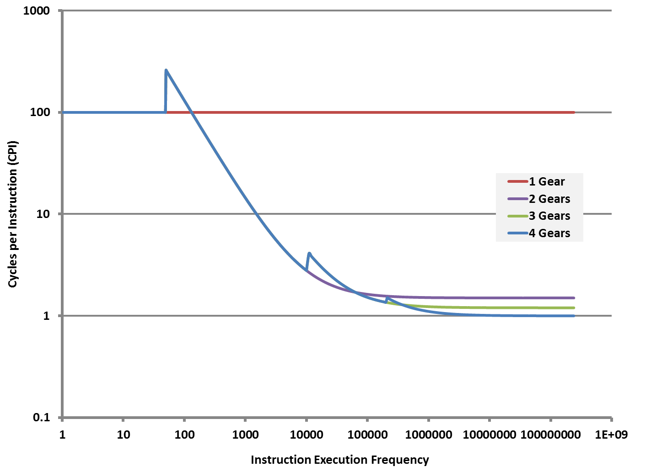
Gears CPI (Clocks per Instruction)

Slide 28
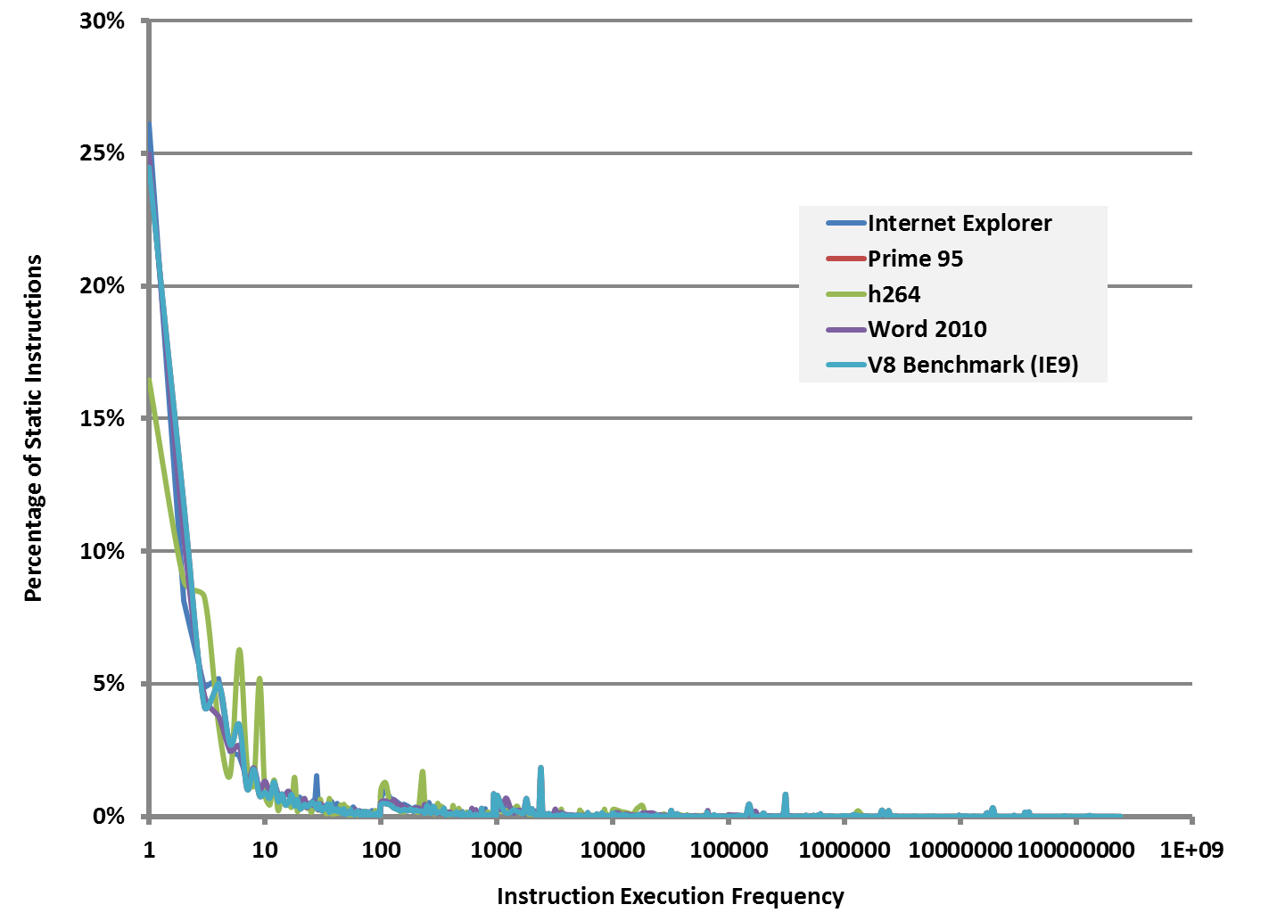
Application Behavior Static Analysis

Slide 29
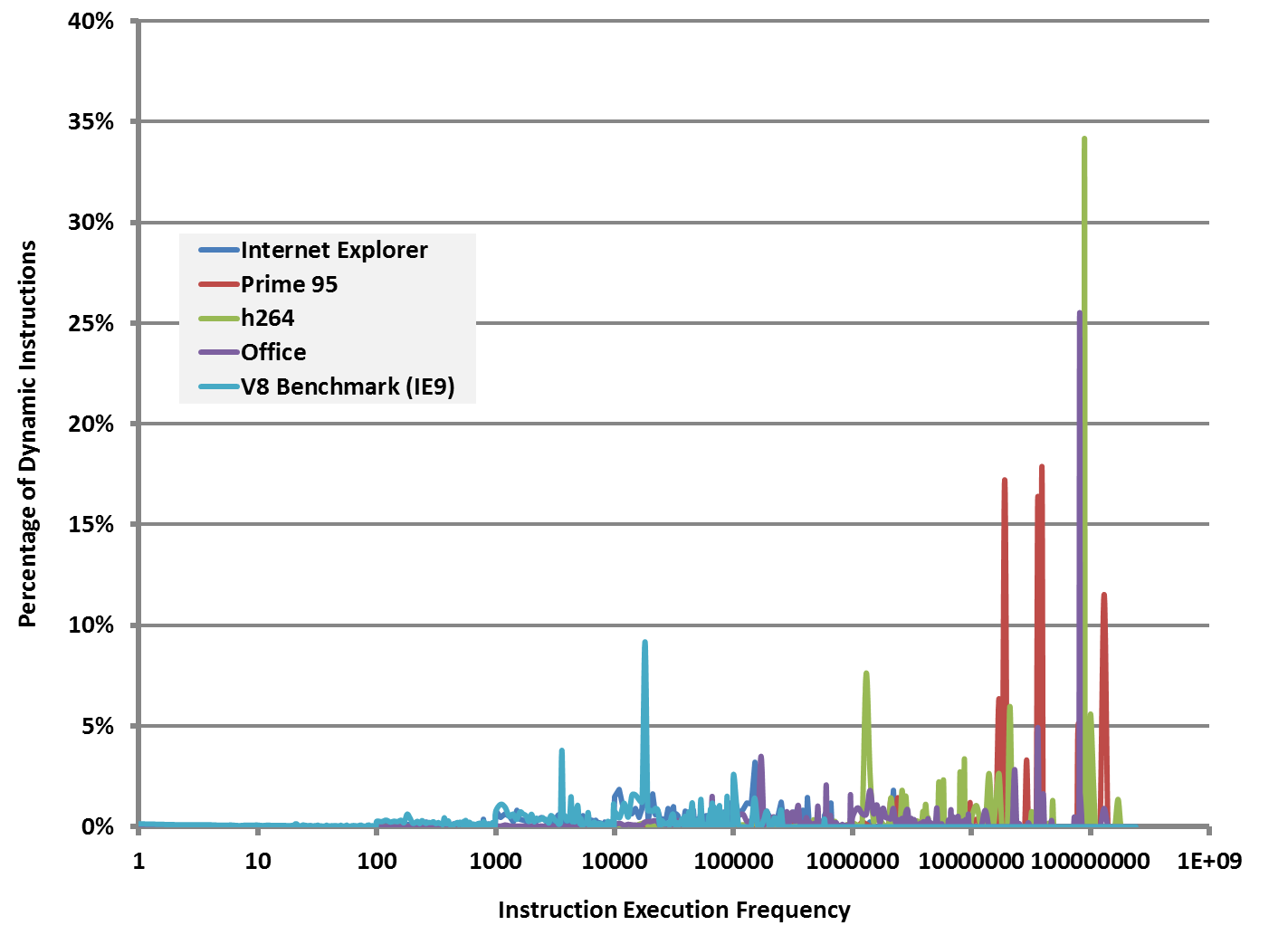
Application Behavior Dynamic Analysis

Slide 30
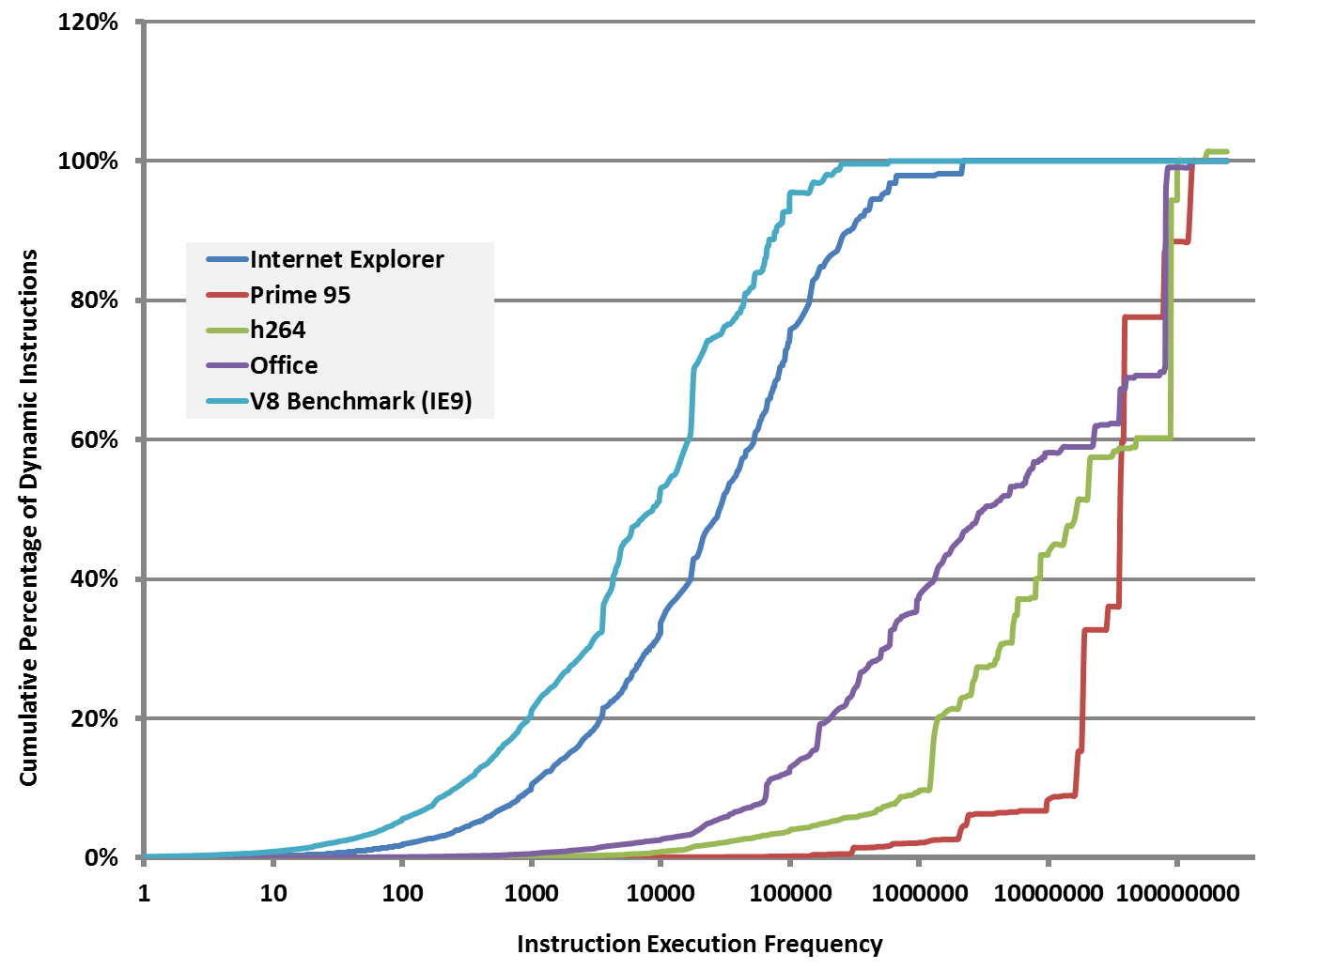
Application Behavior Dynamic Analysis – Cumulative

Slide 31
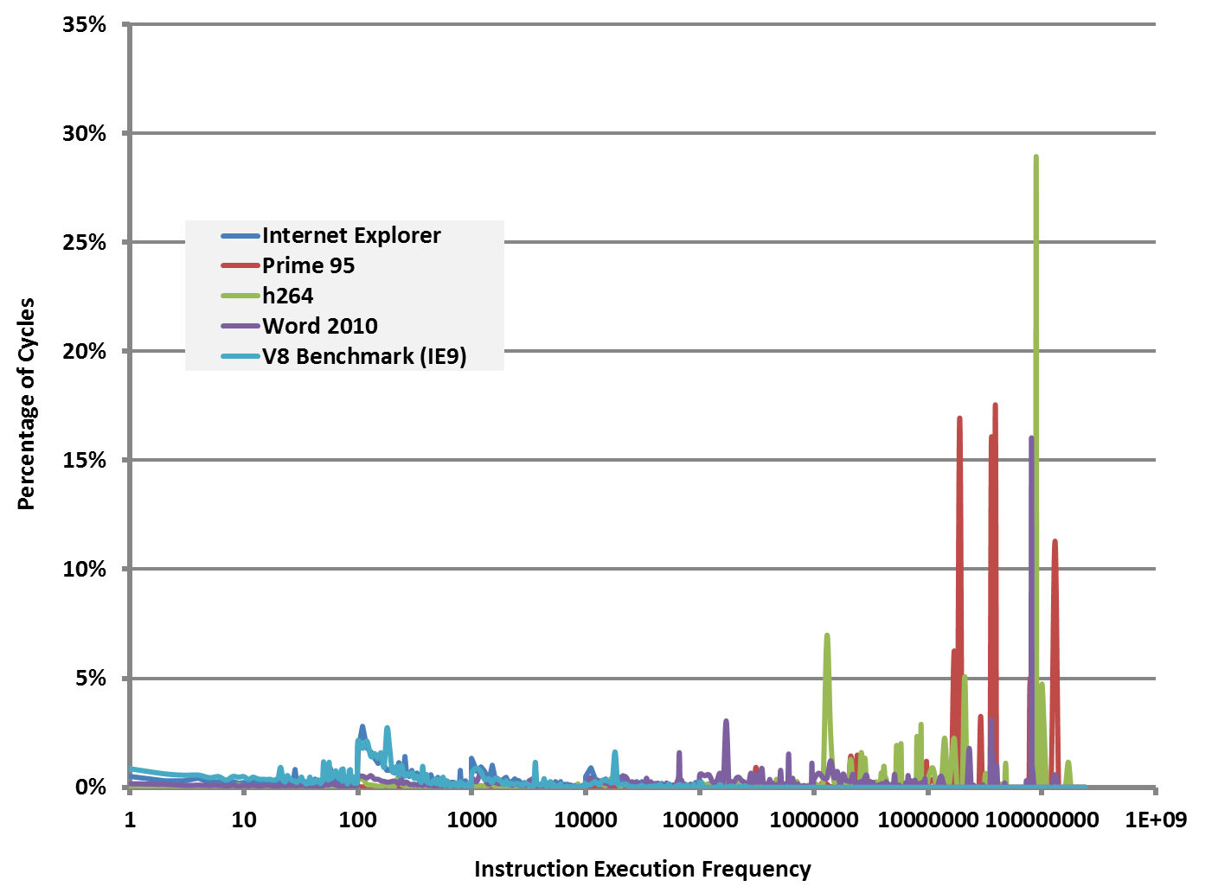
Application Behavior Cycle Analysis

Slide 32
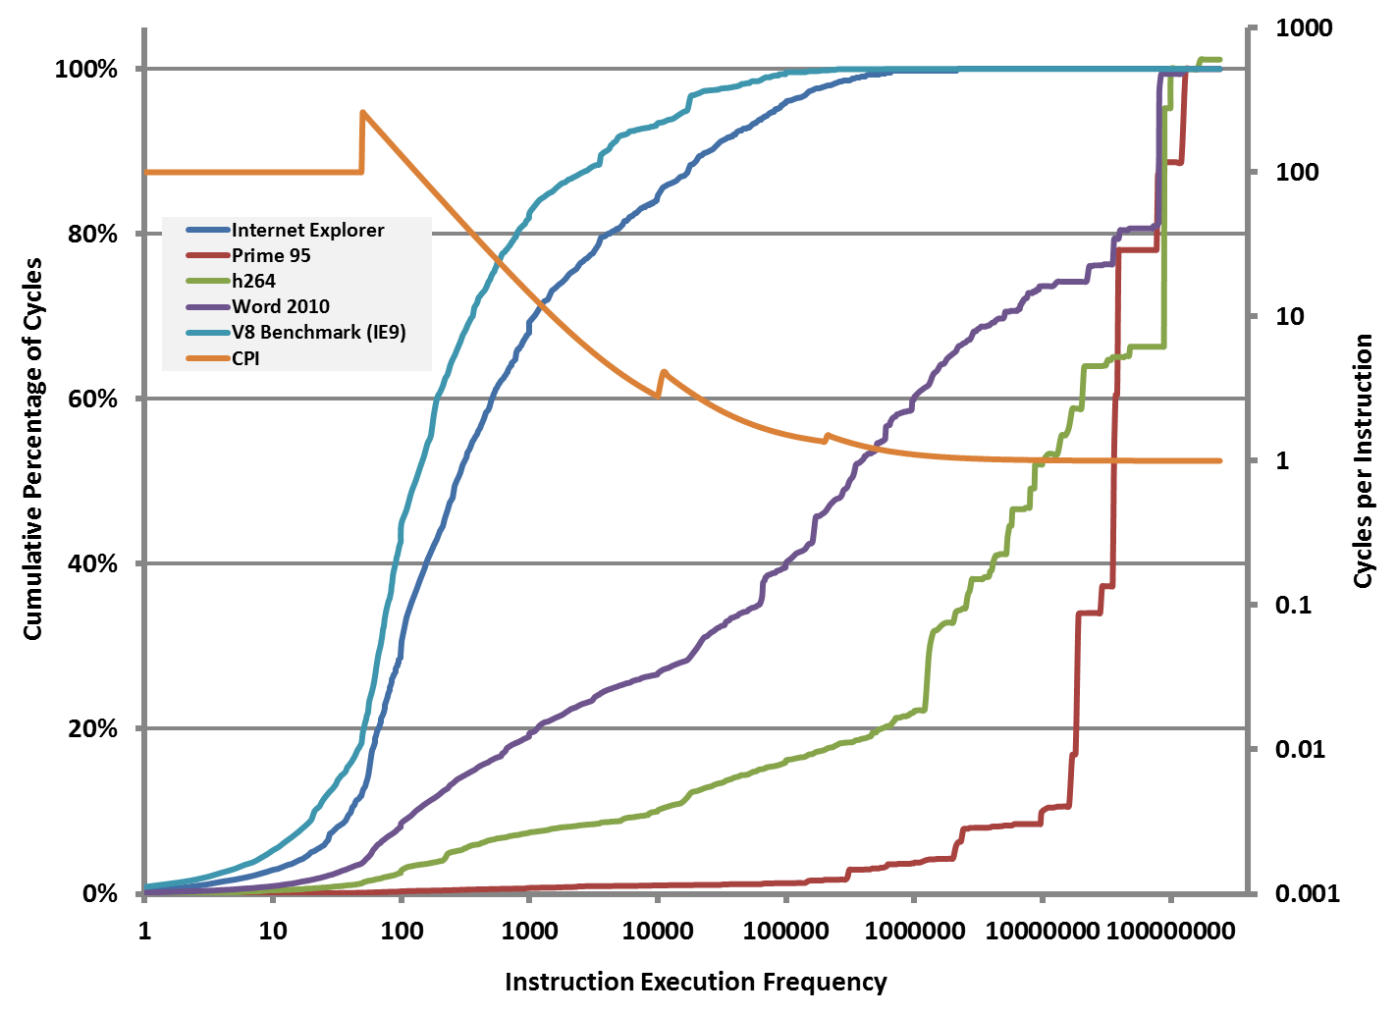
Application Behavior Cycle Analysis

Slide 33
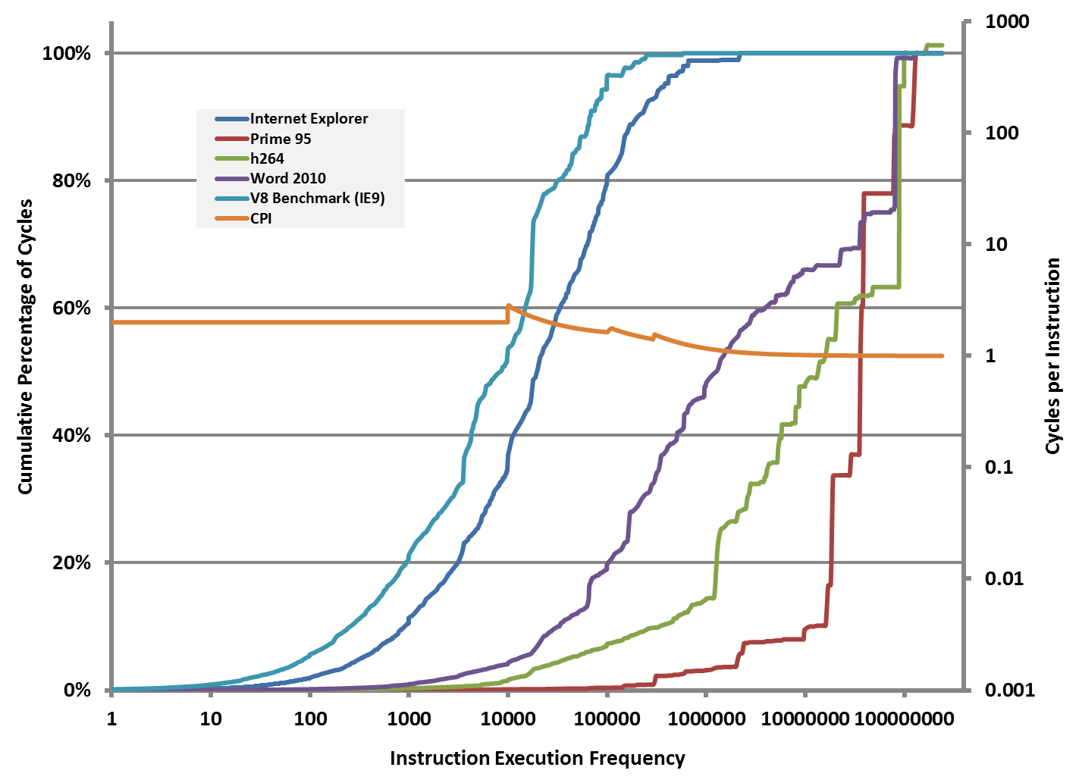
Application Behavior Cycle Analysis – Alternative I

Slide 34
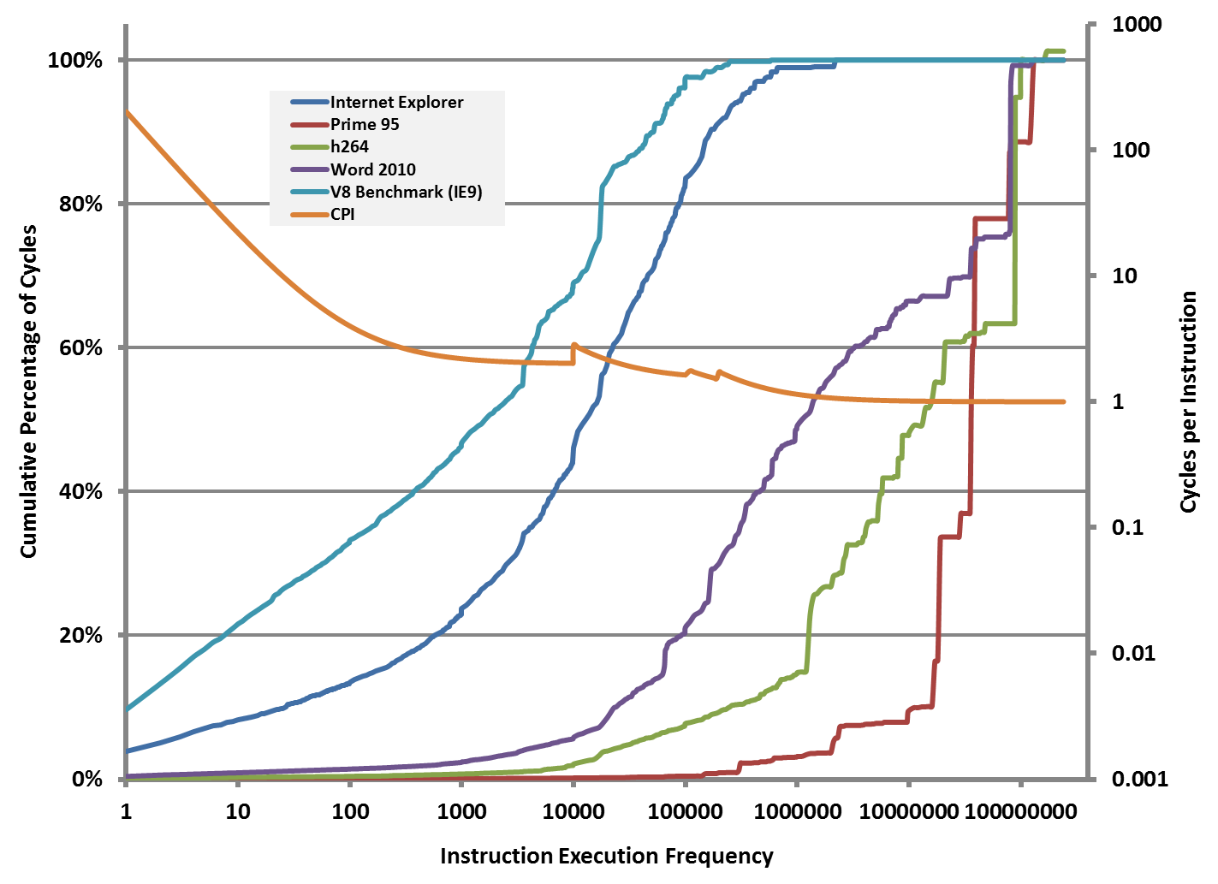
Application Behavior Cycle Analysis – Alternative II

Slide 35
Lesson 2
The first-level gear is incredibly important for perceived performance and snappiness. The interpreter is not good enough.
Higher-level gears are incredibly important for steady-state performance.

Slide 36
Interrupt Latency
Questions
When do we generate the translated code and how do we interrupt the “main x86 thread”?
How does the design of the translator affect real-time response times or interrupt latencies?
How does the design of the translator affect soft real time applications?

Slide 37
Interrupt Latency
Transmeta’s Answer
The main “x86 thread” is interrupted and the translation is generated in-place. The main “x86 thread” then resumes.
Problem
Generating a highly optimized translation can consume millions of cycles, during which the system appears unresponsive.

Slide 38
Lesson 3
The design of a just-in-time compiler must be multi-threaded. The system must guarantee a certain amount of main “x86 thread” forward progress. The optimization thread(s) must run in the background (or on a different core) and must be preemptable.

Slide 39
Part III
Questions?

Slide 41
SMWare
We are Always Looking for Talent!
Thomas Kistler
thomas.kistler@smachines.com

